Slide 1

SAP
APPROVAL WORKFLOW
User Manual - SAP approval workflow
Date: 15/07/2025
RANE MADRAS LIMITED , VELACHARY
User Manual
1 of 20

Slide 2
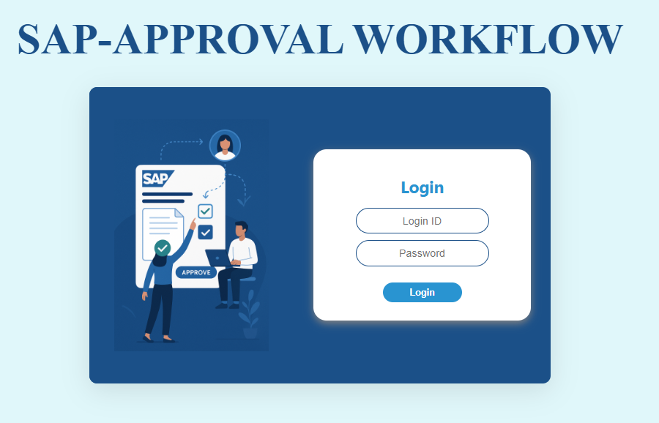
Login Page
2
Gen ID
Password

Slide 3
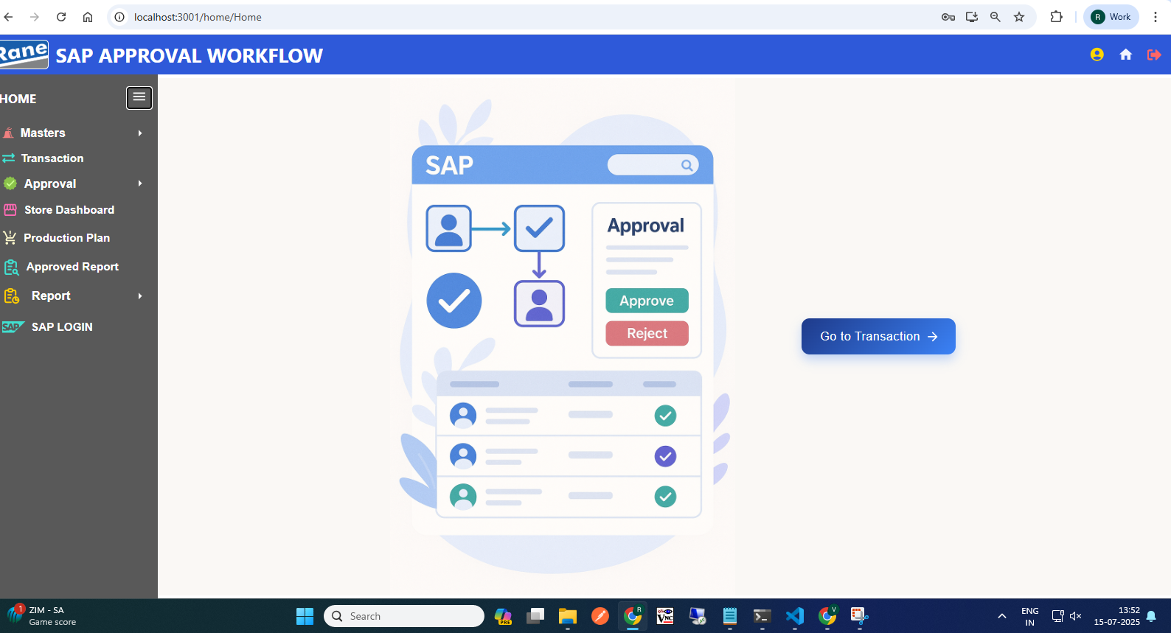
Home Page
Click Here to go to the Transaction Dashboard
3

Slide 4
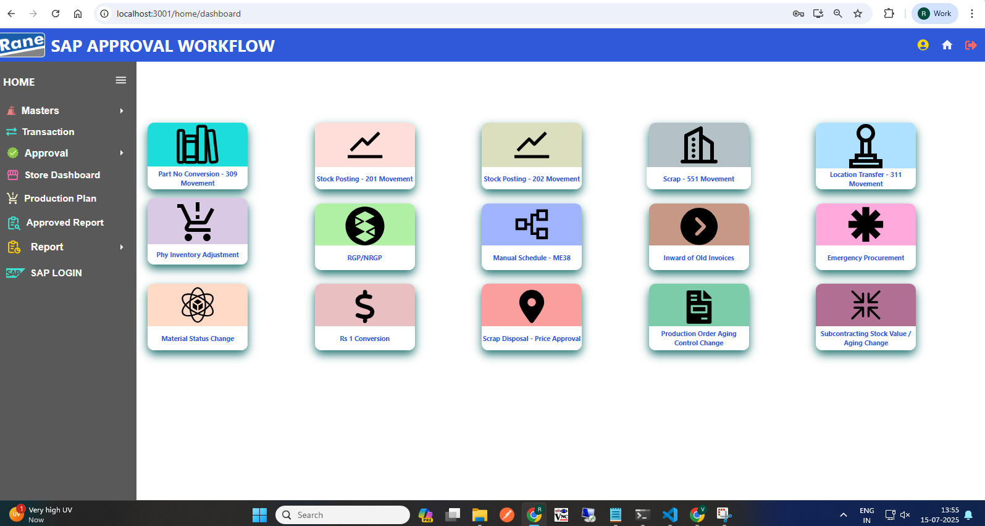
DASHBOARD
Note: R.1 R stands for Reference.
4
R.1
R.2
R.3
R.4
R.5
R.7
R.8
R.6
Create Transaction Request

Slide 5
309 Movement Transaction
Process workflow - R1 :
1.Create Request by Users ( PROD / MMD / QAD / MED )
2.Upload Process:
Download the empty Excel template
Fill in required details Upload completed template to system
3. Upload Output
System validates entries and generates log file downloaded in excel format: i) New Records, ii) Error Records, iii)Duplicate Records
4. Submit for Approval to Level 1 User.
Level 1 : PLANT FINANCE HEAD
Level 2 : PLANT MRPC
Level 3 : PLANT HEAD
Level 4 : CORP FINANCE HEAD
Level 5 : CORP MRPC
5. Requester Page View
Visible Data: Only data uploaded by the logged-in user Shown Statuses: Pending, Under Query Hidden Statuses: Approved, Rejected, Closed Download Option: Filtered by From–To Date & Movement Type
6. Editability
Enabled only if status is Under Query
Editable Fields: (From & To)Material Code, SLoc Code, Valuation Type, Quantity, Batch Non-Editable Fields: Plant Code, Doc ID, Transaction ID, Net Difference Price
7. Resubmit Workflow
Enabled only if status is Under Query Select rows using checkboxes After making corrections, click Resubmit Resubmission goes back to the approver who raised the query
5

Slide 7
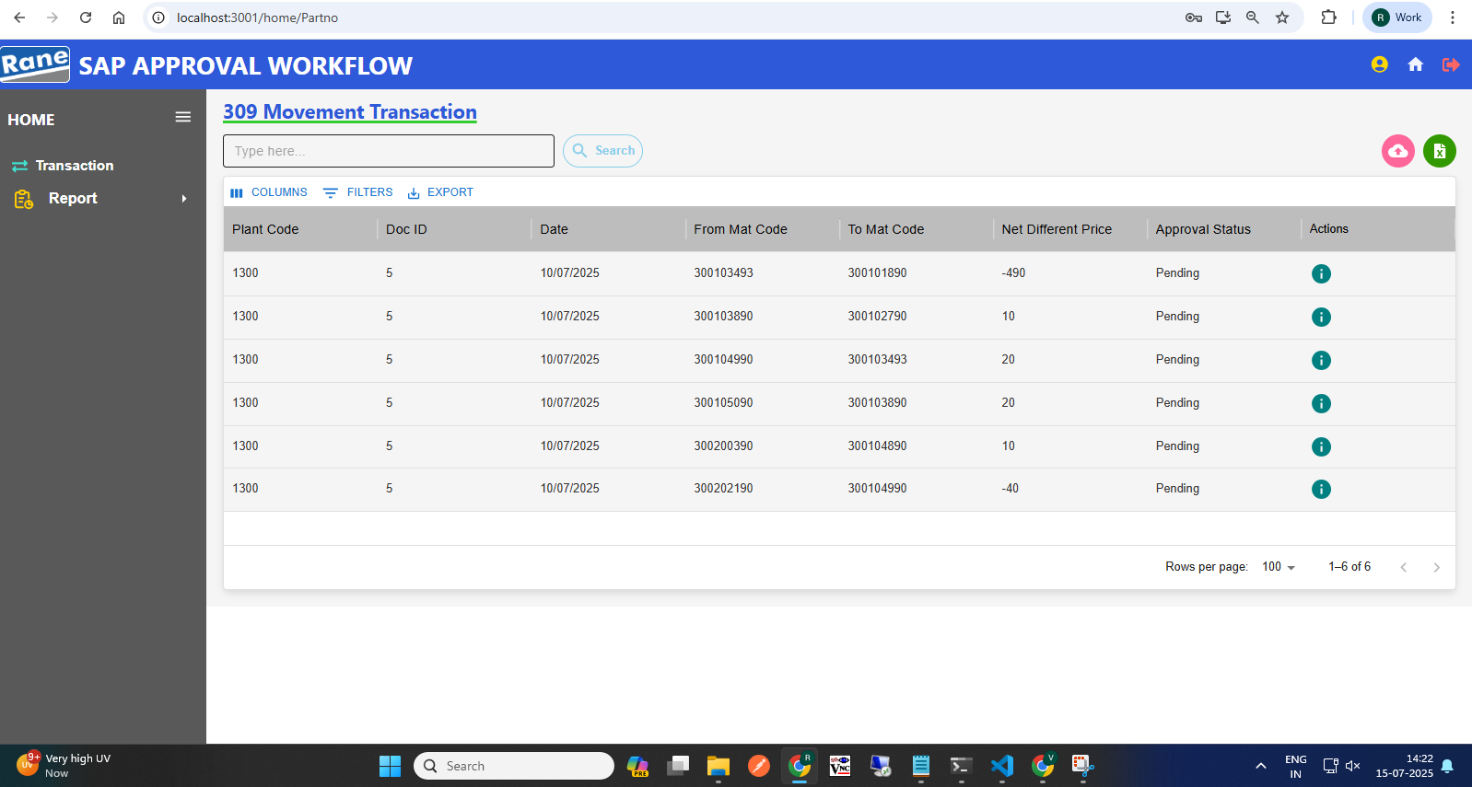
309 Movement Transaction
User Info
New Template
Download User Upload Data only
View the Approval WorkFlow
6

Slide 8
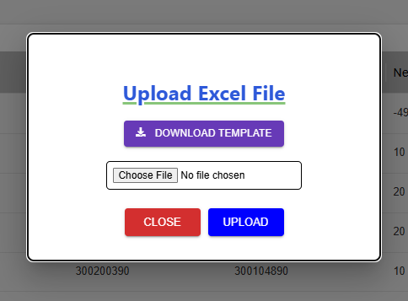
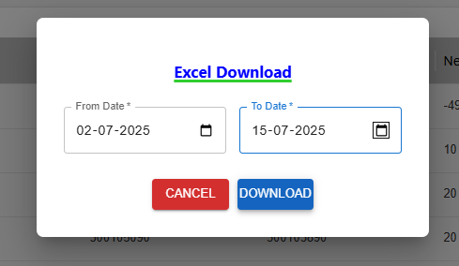
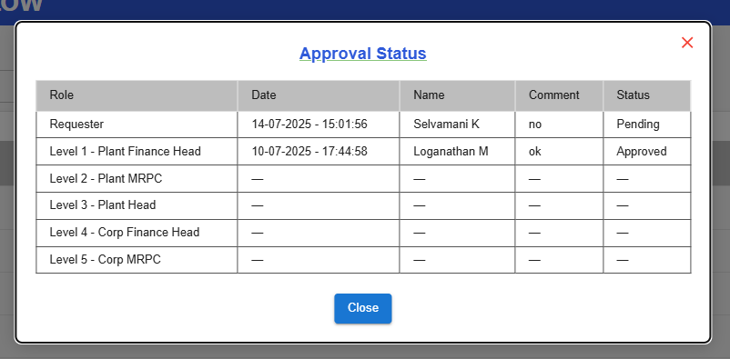
309 Movement Transaction
New Template :
Download Empty Template
After Filled the Required Data, Choose File
Click Here To Upload
Download Data:
View Approval WorkFlow:
Set Data Here
Click Here to Download
7

Slide 9
309 - Approval
Highlights the "Pending" status based on the selected Movement Type.
Data Display
Approval data is shown based on the selected Doc_ID.
View icon displays:-
Plant Code, Requested Date, From & To Material, From & To Quantity, Net Difference Price (per line), Total Net Difference (sum of all)
Action Buttons
Approve - Moves the request to the next approval level.
Reject - Rejects the request. It won’t move forward. Only visible in reports/download.
Under Query - Sends request back to the requester for correction.
View Status - Shows last approved user and their comments.
Download
Users can download complete data related to a selected Doc_ID. Used for internal review or documentation.
8

Slide 10
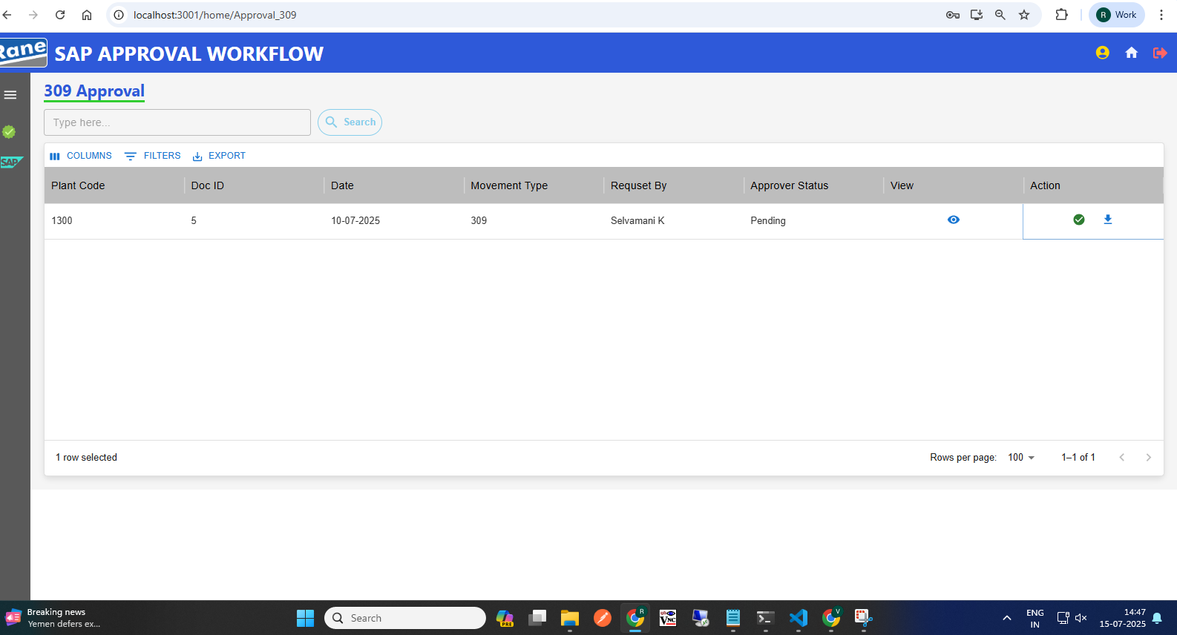
Approval Page - 309
Click Here,View Total Net Difference
Click Here, Approval Action
Click Here, Download Data (Doc_ID)
6 of

Slide 11
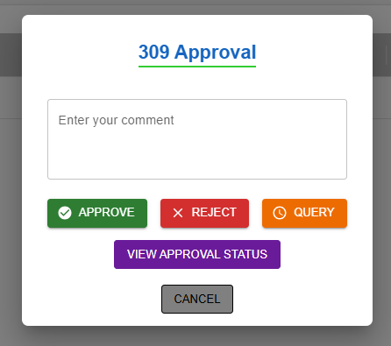
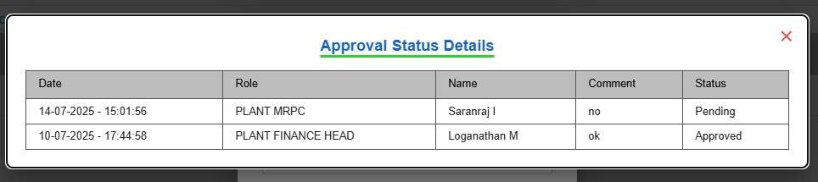
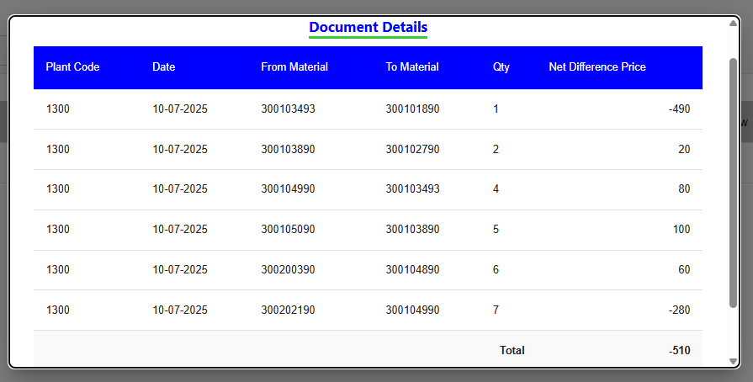
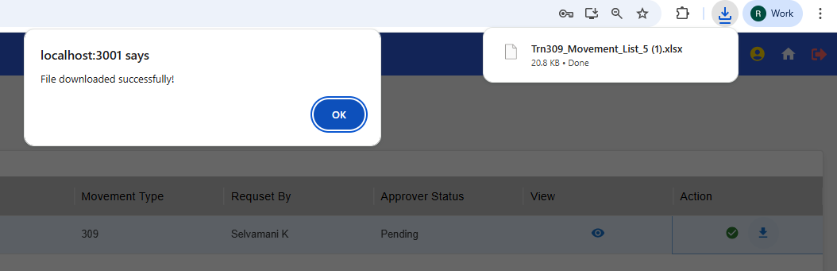
Approval Action:
View Approval Status:
Click Here to View Last Update
View Sum oF Net Difference :
Download Data (Doc_ID)
9

Slide 23

Thank you
Encourage your audience to ask questions or give feedback about your presentation.
Full Name / Title
name@example.com (000) 000-0000
123 Street Name
City, State 12345

